Slide 1

Project Title:
Educational Keystroke Logger using Python & Tkinter
Domain: Cybersecurity
Project Type: Internship Project
Student Name:-
Vedh Kamble

Slide 2

PROBLEM STATEMENT
Keylogging is one of the most commonly used techniques in cyber attacks for stealing sensitive information such as passwords, personal messages, and login credentials.
Many users are unaware of how keyloggers operate or how easily keyboard inputs can be captured if proper security controls are not implemented. There is a need to understand the working, risks, and prevention of keylogging attacks safely and ethically.
This project aims to demonstrate the concept of keystroke logging for educational purposes, focusing on awareness rather than misuse.

Slide 3
Project Description
[write detail description about your project ]
The Educational Keystroke Logger is a Python-based cybersecurity project that demonstrates how keystrokes can be captured within an application environment using the Tkinter GUI framework.
The application logs keyboard inputs typed only inside the program window, ensuring user consent and ethical usage. The logged keystrokes are stored securely in timestamped text files for analysis.
The project highlights:
1)How keylogging works?
2)Why are malicious keyloggers dangerous?
3)How defenders can detect and prevent such threats?
4)This tool does not perform system-wide or background monitoring.

Slide 4

WHO ARE THE END USERS?
Cybersecurity students
Beginners learning ethical hacking concepts
Network and system security learners
Educational institutions
Internship training programs

Slide 5

Technology Used
Programming Language: Python 3
GUI Framework: Tkinter
File Handling: Text files (.txt)
Libraries Used:
  tkinter
  datetime
  os
Development Environment: VS Code
Operating System: Windows
No third-party or external libraries were used.

Slide 6
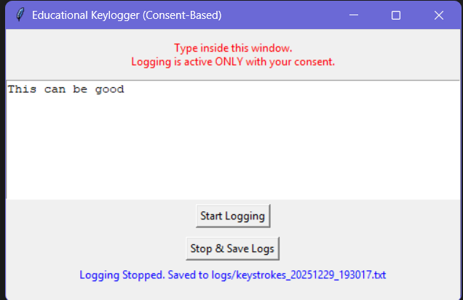
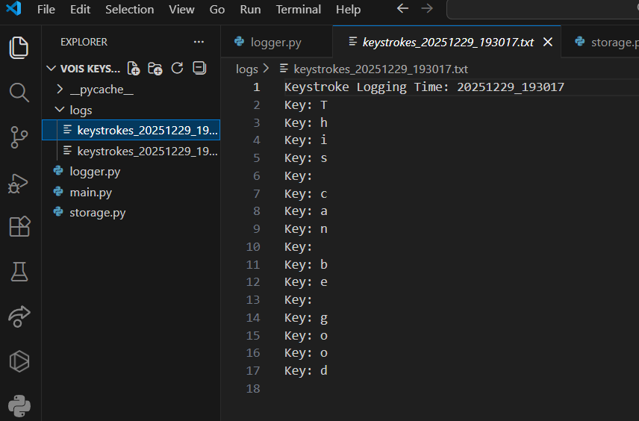
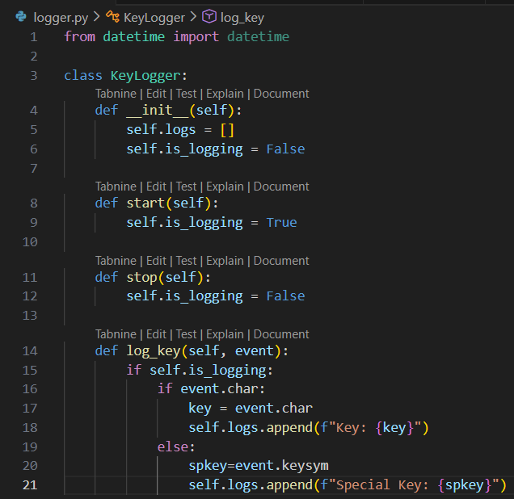
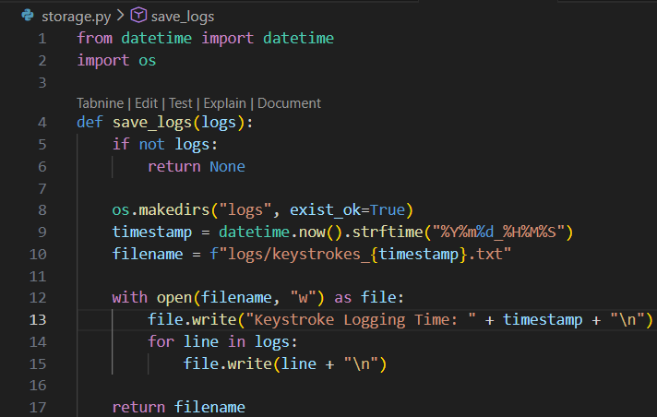
RESULTS
Demo Link

Slide 7
Thank you
.
.

